Slide 1

School of Computer Science and Engineering
Full-Stack based Lung Cancer Risk Prediction using ML,DL and QML
Team members
USN 1RVU22CSE145 - Shashank G
USN 1RVU22CSE112 - Nithish N
USN 1RVU23LCSE007 - Shrinidhi R
USN 1RVU23LCSE005 - Pruthviraj R
Project Guide:
Prof. CVSN Reddy
Assistant Professor/Associate Professor/Professor
School of Computer Science and Engineering
RV University, Bangalore

Slide 2
Outlines
Introduction
Literature survey
Problem statement
Objectives and Expected outcomes
System Requirement Specification
Proposed Methodology
Architecture diagram
Gantt char
References

Slide 3
Introduction
Lung cancer is one of the leading causes of cancer-related deaths worldwide, largely due to late-stage detection, which significantly reduces survival rates. Early identification of individuals at high risk remains a critical challenge in healthcare.
While clinical diagnosis relies on medical tests and expert evaluation, there is a growing need for supportive, data-driven systems that can assist in early risk assessment and promote timely preventive screening.
Machine learning techniques enable the analysis of large-scale healthcare data to uncover hidden patterns that may indicate disease risk before severe symptoms appear.

Slide 4
The scope of this project is to design a full-stack lung cancer risk prediction system that leverages patient data to estimate cancer risk. The system evaluates and compares traditional machine learning models, deep learning approaches, and emerging quantum machine learning (QML/QNN) techniques to assess their predictive performance.
The key challenge addressed in this work is the lack of comparative analysis between classical and quantum-based models for lung cancer risk prediction, as well as the need for an integrated, user-accessible platform that supports early risk awareness and decision-making.

Slide 5
Literature survey
Paper Details | Objective of paper, Techniques/Methods | Key Contribution | Research Gap
Machine Learning Techniques for Lung Cancer Risk Prediction Using Text Dataset.” International Journal of Data Informatics and Intelligent Computing (IJDIIC), Vol. 2, No. 3, pp. 47–56, 2023. | To predict lung cancer risk using machine learning models on structured text datasets. Applied Logistic Regression, Naïve Bayes, and SVM. | Demonstrated that classical ML models can effectively predict lung cancer risk using structured healthcare data. | Limited comparison across advanced ML models; no integration with deep learning or full-stack implementation.
S. P. Maurya, P. S. Sisodia, R. Mishra, and D. P. Singh. “Performance of Machine Learning Algorithms for Lung Cancer Prediction: A Comparative Approach.” Scientific Reports, 2024. | Comparative analysis of multiple ML algorithms on large real-world lung cancer datasets. | Identified performance differences across classifiers using standard evaluation metrics. | Focused only on classical ML; no inclusion of DL or quantum models in a unified framework.
Sweet, M. M. R., Ahmed, M. P., Mozumder, M. A. S., et al. (2024). Comparative Analysis of Machine Learning Techniques for Accurate Lung Cancer Prediction. The American Journal, 2024. | Comparative analysis of machine learning techniques for lung cancer prediction using statistical and ensemble methods. | Highlighted the superior performance of ensemble methods like XGBoost. | Did not explore explainability deeply; lacked comparative integration with DL and QML approaches.

Slide 6
Paper Details | Objective of paper, Techniques/Methods | Key Contribution | Research Gap
Huang, S., Arpaci, I., Al-Emran, M., Kılıçarslan, S., et al. (2023). A Comparative Analysis of Classical Machine Learning and Deep Learning Techniques for Predicting Lung Cancer Survivability. Multimedia Tools and Applications, 2023. | Comparative analysis of classical ML and Deep Learning models for lung cancer survivability prediction. | Showed deep learning can outperform classical ML in complex pattern detection. | Focused on survivability rather than risk prediction; lacked full-stack system validation.
B. Dutta. “Comparative Analysis of Machine Learning and Deep Learning Models for Lung Cancer Prediction Based on Symptomatic and Lifestyle Features.” Applied Sciences (MDPI), 2025. | Systematic comparison of ML and DL models based on symptomatic and lifestyle features. | Demonstrated improved predictive accuracy using neural network models. | Did not include quantum ML or unified evaluation across all model types.
P. R. Radhika, R. A. S. Nair, and G. Veena. “A Comparative Study of Lung Cancer Detection Using Machine Learning Algorithms.” 2019 IEEE International Conference on Intelligent Computing and Control Systems (ICCS), 2023 | Comparative study of classical ML algorithms for lung cancer detection. | Established baseline ML performance benchmarks. | Outdated methods; no deep learning, explainability, or quantum ML exploration.

Slide 7
Problem statement
Early identification of individuals at high risk of lung cancer remains a significant challenge due to the influence of multiple factors such as age, smoking habits, occupational exposure, and family history. Accurate risk prediction requires analyzing complex and multi-dimensional healthcare data.
Although existing machine learning models have been applied to lung cancer risk prediction, their performance varies across different datasets and evaluation metrics. Most studies focus on a single modeling approach, and there is limited comparative analysis between traditional machine learning, deep learning, and emerging quantum machine learning (QML/QNN) techniques.

Slide 8
Additionally, many existing systems lack an integrated, user-accessible framework for systematic evaluation and deployment.
To address these limitations, this project proposes a unified full-stack lung cancer risk prediction system that systematically evaluates and compares classical machine learning, deep learning, and quantum machine learning models using structured healthcare data.
The novelty of this work lies in providing a comprehensive comparative framework along with an end-to-end implementation that enables practical evaluation and performance analysis of advanced predictive techniques.

Slide 9
Objectives and Expected Outcomes
Objectives:
To apply lung cancer datasets on machine learning, deep learning, and quantum machine learning (QML/QNN) models.
To preprocess and prepare healthcare data for effective model training and evaluation.
To compare different models based on performance metrics such as accuracy and error rates.
To analyze model behavior using feature importance and interpretability techniques.
To enable the complete system through a full-stack architecture.
To develop a simple web-based GUI for user input and visualization of prediction results.

Slide 10
Expected Outcomes:
Comparative analysis of ML, DL, and QML/QNN models for lung cancer risk prediction.
Identification of the most reliable model based on accuracy, false positives, and stability.
Objective model evaluation using standard performance metrics and explainability
methods.
A working full-stack web prototype demonstrating lung cancer risk prediction.

Slide 11
System Requirement Specification
Software requirement:
Operating System – Windows 10/11, Linux, or macOS.
Programming Language – Python 3.x for backend development, machine learning model training, and prediction logic.
Development Environment – Google Colab / Jupyter Notebook / Anaconda / VS Code / PyCharm.
Web Framework – Flask for handling HTTP requests, routing, backend logic, and rendering templates.
Frontend Technologies – HTML for UI structure and CSS for styling the web interface.
Templating Engine – Jinja2 (built-in with Flask) for rendering dynamic HTML pages.
Data Processing Libraries – NumPy and Pandas for numerical operations, dataset handling, cleaning, and preprocessing.
Machine Learning Library – Scikit-learn for model training and evaluation (Decision Tree, Random Forest, KNN, SVM, Naïve Bayes, Train-Test Split, StandardScaler, LabelEncoder, Accuracy Score, Confusion Matrix, Classification Report).
Deep Learning Framework – TensorFlow and Keras (Sequential model and Dense layers).
Quantum machine learning:IBM Qiskit
Model & Environment Management – Pickle for saving/loading the trained model and Virtual Environment (.venv) with pip/Anaconda for dependency management.

Slide 12
Hardware requirement:
Processor (CPU) – Minimum Intel Core i3 / AMD Ryzen 3; Recommended Intel Core i5/i7 or AMD Ryzen 5/7 for faster ML model training.
RAM (Memory) – Minimum 4 GB; Recommended 8 GB or higher for smooth execution of machine learning and deep learning models.
Storage – Minimum 20 GB free space; SSD recommended for better performance and faster data processing.
Graphics Support (Optional) – Integrated graphics sufficient for ML; T4 GPU within Google colab support recommended for deep learning tasks.
Internet Connection – Required for Google Colab usage, downloading datasets, and installing libraries.
System Type – 64-bit operating system recommended for compatibility with Python libraries and frameworks.

Slide 13
Proposed Methodology
ML Model Training in Google Colab:
Dataset Loading and Inspection
Upload lungcancer.csv to Google Colab, load it using Pandas, and perform initial exploration by checking dataset shape, column names, data types, and previewing the first few rows to understand features and the target variable.
Data Preprocessing and Encoding
Separate input features (X) and target variable (y). Encode categorical variables such as GENDER using Label Encoding and convert the LUNG_CANCER target variable into numerical format (0 = No, 1 = Yes) to prepare the data for machine learning models.
Train-Test Split
Split the dataset into training (80%) and testing (20%) sets using train_test_split() with a fixed random state to ensure reproducibility and fair model evaluation.
Feature Scaling
Apply StandardScaler to standardize numerical features in both training and testing sets. This prevents features with larger values from dominating the model and improves performance for algorithms like KNN and SVM.

Slide 14
Model Training and Performance Evaluation Train multiple classification models including K-Nearest Neighbors (KNN), Decision Tree, Random Forest, Gaussian Naive Bayes, and Support Vector Machine (SVM). Evaluate each model using:
Accuracy Score
Confusion Matrix
Classification Report (Precision, Recall, F1-Score) Compare results and identify the best-performing model.
Prediction and Result Analysis
Use the best-trained model to predict lung cancer risk for new input data. Ensure user input undergoes the same preprocessing steps (encoding and scaling). Finally, compare model performances and summarize insights regarding the most effective algorithm for lung cancer prediction.

Slide 15
Methodology (ML with Flask Full-Stack Integration):
Problem Definition & Data Collection
Define the objective to predict lung cancer risk using health indicators (smoking, wheezing, alcohol consumption, coughing, chest pain) and collect the dataset (lungcancer.csv) containing features and target variable.
Data Preprocessing
Load the dataset using Pandas, clean and standardize column names, rename inconsistent fields, select relevant features and target variable, and prepare data for model training.
Model Development & Training
Use Scikit-learn’s DecisionTreeClassifier for binary classification, train the model using selected features, evaluate performance, and serialize the trained model using Pickle (model.pkl).
Backend Development (Flask Integration)
Build a Flask application to load the trained model, create routes for home and prediction pages, handle POST requests, validate inputs, convert data into NumPy arrays, and generate predictions.
Frontend Development (Full-Stack Implementation)
Design a web interface using HTML, CSS, and Jinja2 templates to collect user inputs through forms and display prediction results dynamically.
Testing, Deployment & Enhancement
Test the application locally using Flask server, validate prediction outputs, and enhance the system with visualization, cross-validation, cloud deployment, or database integration.

Slide 16
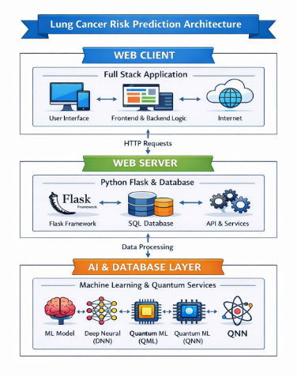
Architecture diagram
Web Client (Presentation Tier): This is the user interface where patients enter their details and view results. It sends data to the server through HTTP requests.
Web Server (Application Tier): Flask server processes user input, performs validation, and interacts with the database. It calls the ML model and returns the prediction result.
AI & Database Layer (Intelligence Tier): This layer contains ML/DNN/QNN models that analyze medical data and predict lung cancer risk. I

Slide 17
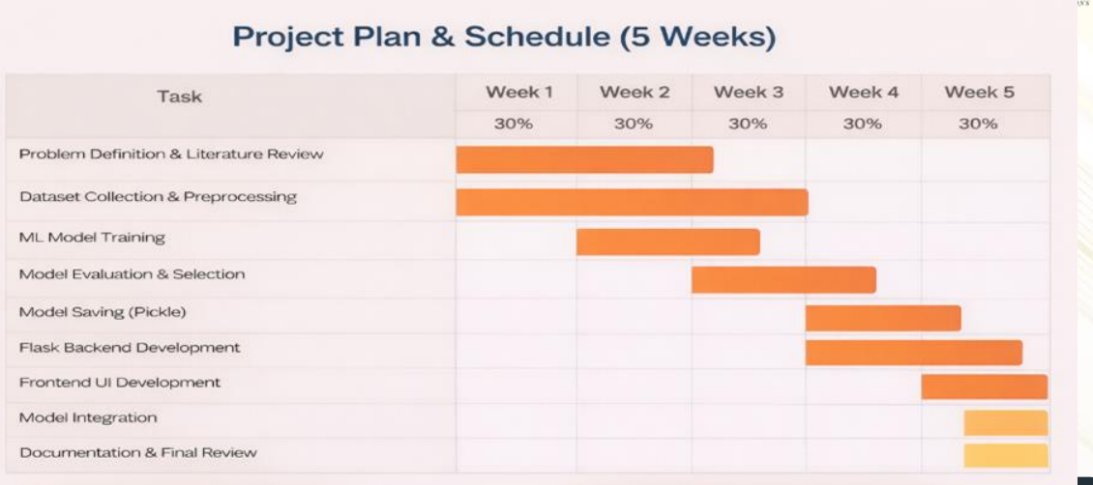
Gantt Chart

Slide 18
Project Progress so far:
Built prototype for ML but yet to be tuned
Partially Completed Integration of python Flask Frame work with ML
Prototype ready
Next Phase activity:
SRS-> IEEE template
System test-> IEEE 829
Learn Deep Learning

Slide 19
Test activities:
1)Planning to use IEEE 8 2 9 template test plan Document for preparing test
2)Understanding project functionality from SRS Document
3) Next Deliverables # Test Plan
# Test Cases

Slide 20
References
Application of machine learning in lung cancer prediction — Dingjingmu Yang (2024). This paper reviews ML models applied for lung cancer prediction using various datasets and highlights the effectiveness of ML techniques in early detection.
Optimizing Lung Cancer Risk Prediction with Advanced Machine Learning Algorithms and Techniques (2024). This article discusses advanced ML methods like Random Forest, XGBoost, and Logistic Regression for improved lung cancer risk prediction.
Lung cancer risk prediction using augmented machine learning pipelines with explainable AI — Pavithran M.S. et al. (2025). This research emphasizes augmentation techniques and explainable AI in ML pipelines to improve prediction accuracy for lung cancer datasets.
AI-Driven Predictive Modeling for Lung Cancer Detection Using Synthetic Data Augmentation and Random Forest Classifier (2025). This work focuses on synthetic data augmentation and Random Forest classifier performance for lung cancer prediction.
The role of machine learning in lung cancer prediction: Insights from a multifactorial risk assessment (2024). This article explores ML models and their effectiveness in assessing multifactorial risk indicators of lung cancer.

Slide 21
Thank You

